Slide 1

Projectile Animation
ELECTRICAL AND COMPUTER ENGINEERING, COLLEGE OF ENGINEERING AND APPLIED SCIENCE

Slide 2
Goals
The idea of the project is to illustrate the physical concept of projectile motion through a simple animation and a fun game!

Slide 3
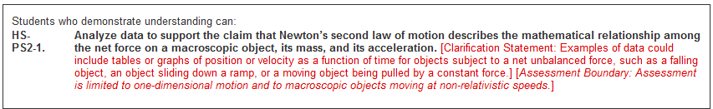
Applicable Education Standards
See page from Next Generation Science Standards:
https://www.nextgenscience.org/pe/hs-ps2-1-motion-and-stability-forces-and-interactions

Slide 4
Abstract
The mathematical equations of motion will be worked into a Python program and the path of the projectile will be plotted onto a 2-D graph.
This module will be split up into phases based on the functionality.
Along the way, you will also learn:
Basic programming concepts
Use of libraries in Python (numpy, matplotlib)
Concept of projectile motion and its equations

Slide 5
Materials
This will be a purely software-based project. Therefore, you will only need the Raspberry Pi and a working internet connection.
Programming will be done on Python 2.7 using numpy and matplotlib libraries.
Before you get started, it is assumed that you have a working Raspberry Pi and you know how to get into the graphical interface. If not, it is advised to look at the following presentations in the Raspberry Pi – Archive:
Introduction to Raspberry Pi
Setting up Raspberry Pi for Classroom Environment
Introduction to Linux
At this point you should be able to connect to the Raspberry Pi and work your way around it.

Slide 6
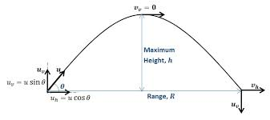
And we begin!
(P.s. Make sure your pi is connected to the internet)

Slide 7
Libraries
Before we start programming, we need to make sure that we have the appropriate libraries.
NumPy is a fundamental package for scientific computing with Python. It contains a host of useful functions that is otherwise not available with regular Python. NumPy also works well with arrays and matrices with large amount of data. NumPy Quickstart Tutorial
Matplotlib is a 2-D plotting library for Python. It is the go-to library for making graphs in Python, especially its pyplot feature which we will be using extensively. Matplotlib.Pyplot Tutorial
These libraries are widely used in the Python community and hence, have a lot of online support. This means that if you have a question then someone has probably already answered it. Just Google it!
Knowledge of these libraries is a must for those wanting to learn Python as a language.

Slide 8

Downloading libraries (1/2)
Before we start, it is always a good idea to upgrade the previously installed libraries on the Pi.
Open up a terminal, by pressing Ctrl+Alt+T at the same time
At the prompt type sudo apt-get upgrade python
Wait. This may take from anywhere between 2 minutes and infinity
Now we are ready to install NumPy
Simply type into the prompt, sudo apt-get install python-numpy
You should see something like this:

Slide 9

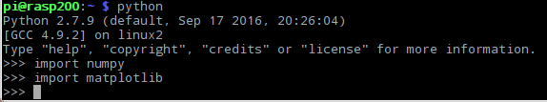
Downloading libraries (2/2)
Next we will move onto matplotlib, type sudo apt-get install python-matplotlib at the prompt
Now to check whether we have them both installed
Type python into the prompt
Then type import numpy and press Enter
Followed by import matplotlib and Enter
If you get the following output, you are good to go
If you get something different, go back and re-do the last two slides.

Slide 10

To coding and beyond!
Download the TWO Python files (AnimateProjectile.py & AnimateBounce.py) in the Dropbox folder from your Pi and place it in a convenient location. Use the Web Browser located in the top left corner of your Pi desktop for this.
AnimateProjectile.py contains code to play the projectile game. You will be given a random target range and you will have 3 chances to hit this target by choosing the right initial velocity and angle. Make sure you do your calculations first before punching in the numbers!
AnimateBounce.py contains code to plot the path of a single projectile through multiple bounces. Here the inputs will be the launch angle, initial velocity and coefficient of restitution. This is useful when comparing the height to which the projectile will rise after each bounce.

Slide 11
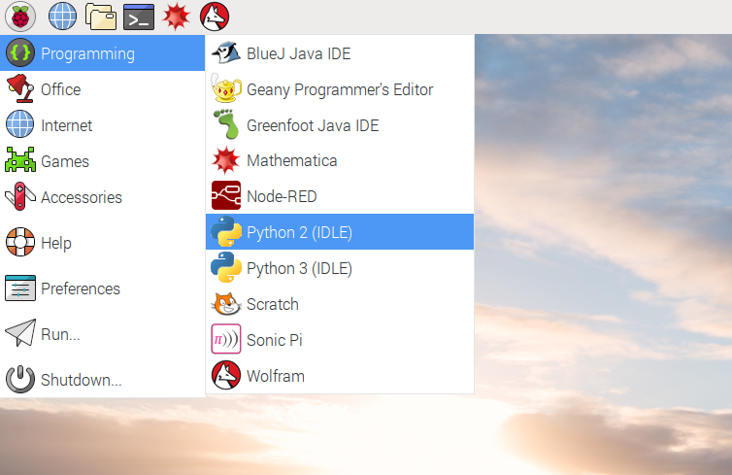
Edit. Run. Observe. Repeat. (Phase I)
First we need to open the Python 2 (IDLE) from the Programming menu in the upper left corner.
From the File option in the upper left corner of the Python shell, click on Open… and navigate to and choose the AnimateProjectile.py file from the menu. (This is similar to how you choose a file in Windows or Mac)
The code will then open up in a separate window. From the Run option at the top of this window, choose Run Module.

Slide 12
How to: AnimateProjectile.py (Phase I)
Once you run the module, these are the steps you will follow:
Watch the terminal for relevant messages.
For the first try, guess numbers for initial velocity and angle
Enter initial velocity of the projectile
Enter the angle of launch for the projectile
Observe the animation for that projectile
If you hit the target, then you’re good to go!
If not you can always try again by recalculating your numbers
Save the final image (optional)

Slide 13
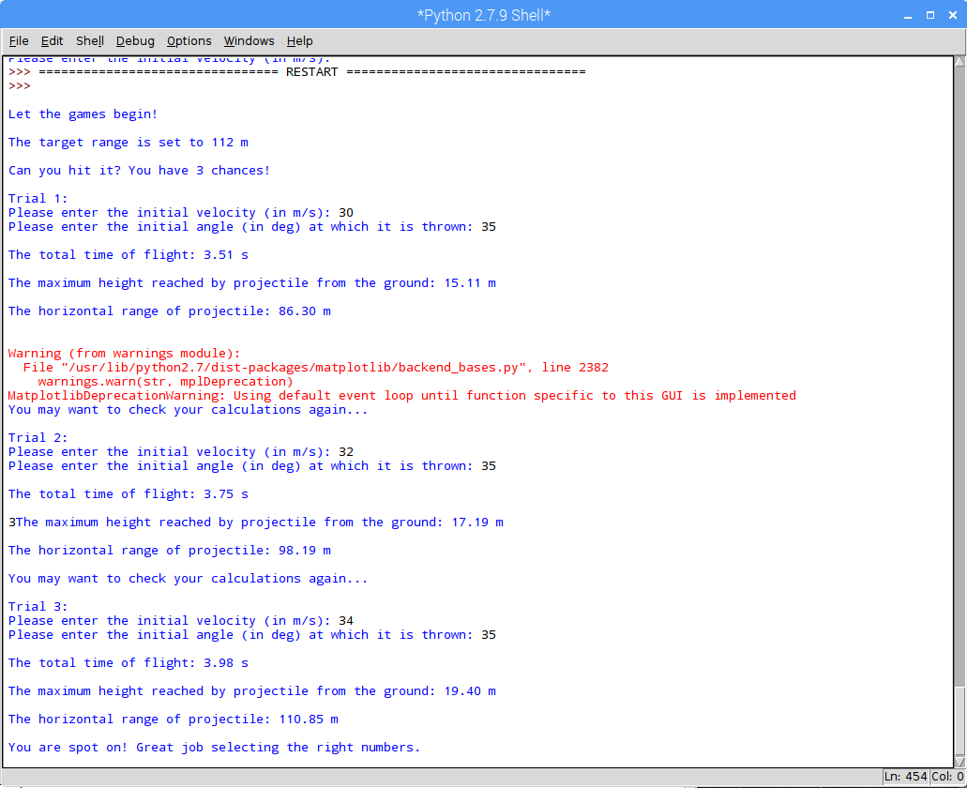
Final Terminal (AnimateProjectile.py)

Slide 14
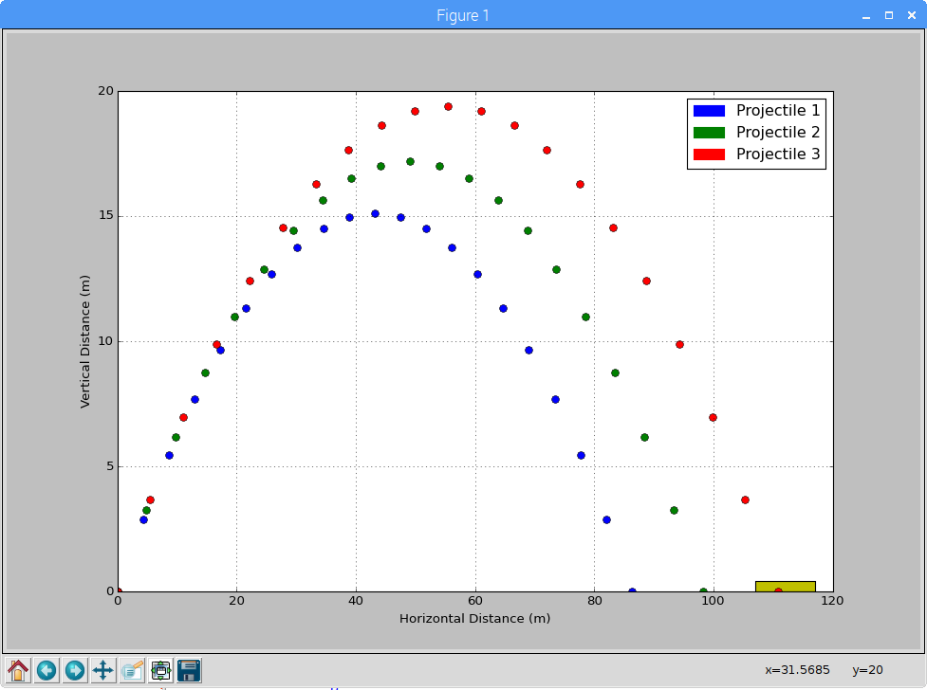
Final Plot (AnimateProjectile.py)

Slide 15
Suggested Activities (Phase I)
The module can be used to launch two projectiles with launch angles complementary to each other i.e. sum up to 90º with the same initial velocities to observe the flight paths
This module can be used to see how the range and height varies with change in velocities keeping the launch angle constant. The data can be collected and analyzed to determine the relationship between the velocity and range/maximum height
Experiment by changing the value of g (acceleration due to gravity) to observe the path of the projectile on different planets in the solar system
Use the code given to simulate the path of a projectile using your OWN equations of motions! (by changing appropriate portions in the code)

Slide 16
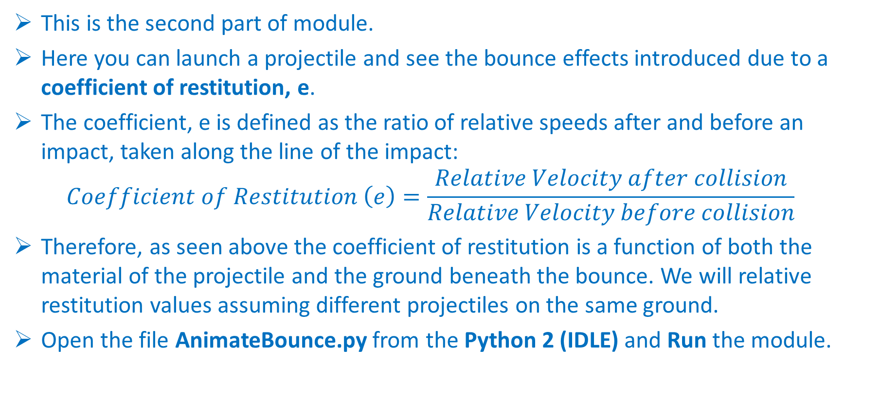
Edit. Run. Observe. Repeat. (Phase II)
This is the second part of module.
Here you can launch a projectile and see the bounce effects introduced due to a coefficient of restitution, e.
The coefficient, e is defined as the ratio of relative speeds after and before an impact, taken along the line of the impact: $Coefficient of Restitution \left(e\right)=\frac{Relative Velocity after collision}{Relative Velocity before collision}$
Therefore, as seen above the coefficient of restitution is a function of both the material of the projectile and the ground beneath the bounce. We will relative restitution values assuming different projectiles on the same ground.
Open the file AnimateBounce.py from the Python 2 (IDLE) and Run the module.

Slide 17
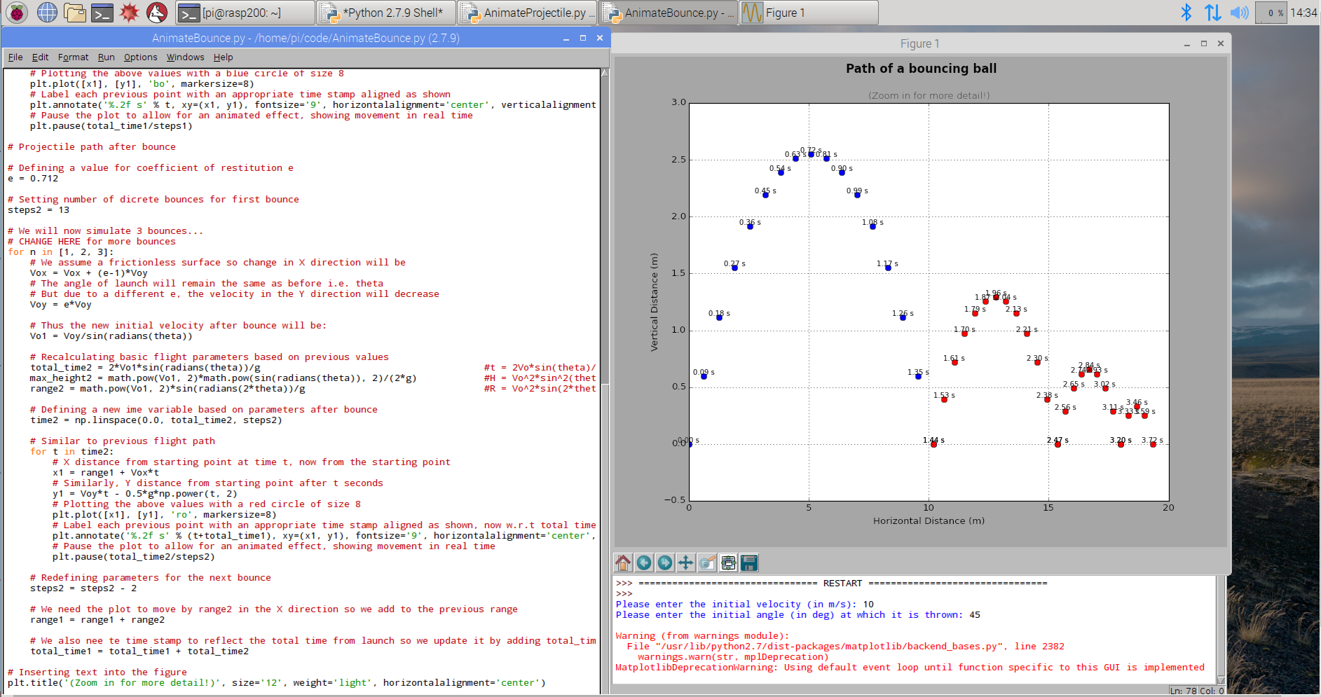

How to: AnimateBounce.py (Phase II)
Enter the initial velocity of the projectile
Enter the launch angle in degrees
Sit back and enjoy the show!
Save the final image (optional)
(To save an image, click the little floppy
disk symbol in the bottom left portion
of the plot.
Give the image a name and click Save)

Slide 18
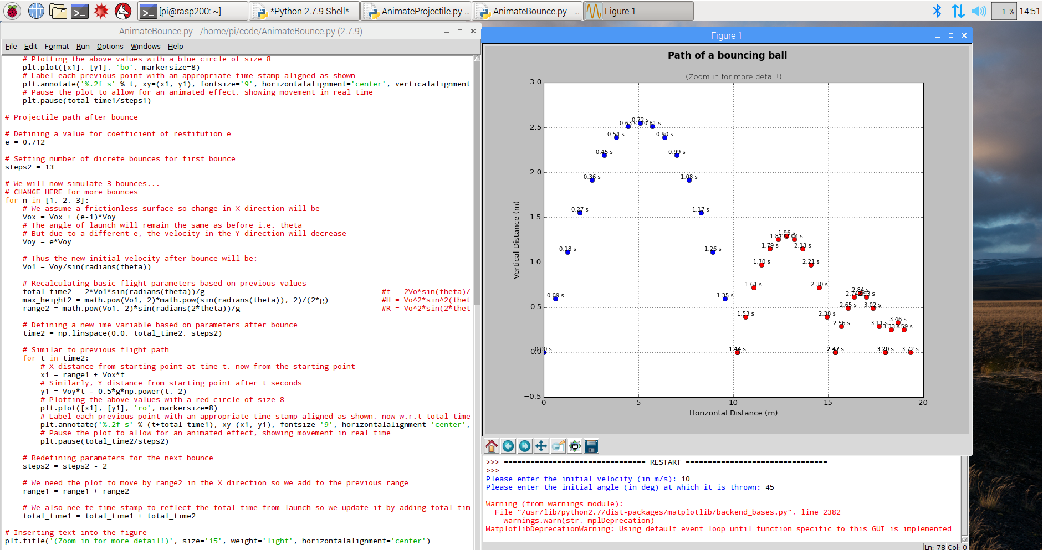
Final Screen (AnimateBounce.py)

Slide 19
Suggested Activities (Phase II)
Included in the code is e = 0.712 for a tennis ball, now that value can be changed to reflect different materials i.e. a glass marble (e = 0.658) or a golf ball (0.858) and observing how it affects the bounce
The number of bounces can be changed in the code to compare the maximum heights to which the projectile rises after each bounce. This will allow us to predict the height of the next bounce based on the height of the previous bounce
The precision of the module can be increased by plotting the position of the projectile for smaller intervals in time. Increase the number of discrete points from 21 to a higher number to get a more continuous plot

Slide 20
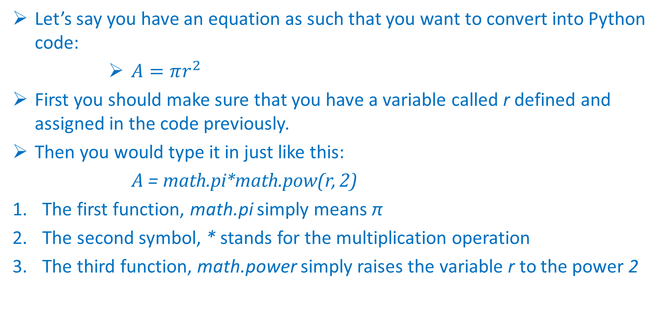
How To: Code Equations (1/2)
Let’s say you have an equation as such that you want to convert into Python code:
$A=πr^{2}$
First you should make sure that you have a variable called r defined and assigned in the code previously.
Then you would type it in just like this:
A = math.pi*math.pow(r, 2)
The first function, math.pi simply means π
The second symbol, * stands for the multiplication operation
The third function, math.power simply raises the variable r to the power 2

Slide 21
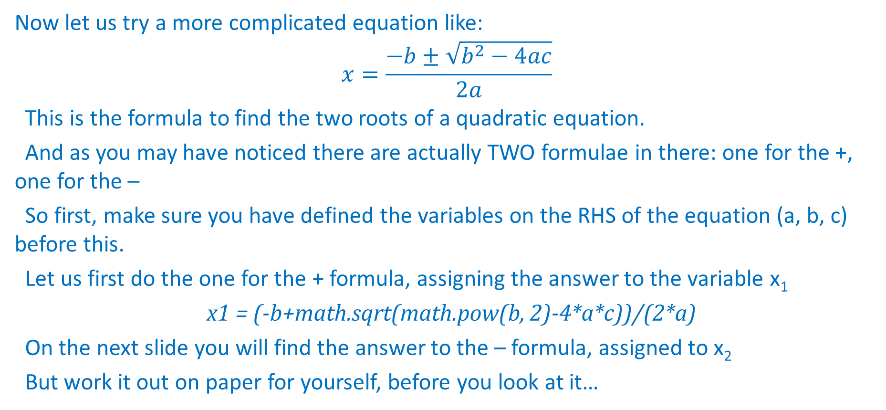
How To: Code Equations(2/2)
Now let us try a more complicated equation like:
$$x=\frac{−b±\sqrt{b^{2}−4ac}}{2a}$$
This is the formula to find the two roots of a quadratic equation.
And as you may have noticed there are actually TWO formulae in there: one for the +, one for the –
So first, make sure you have defined the variables on the RHS of the equation (a, b, c) before this.
Let us first do the one for the + formula, assigning the answer to the variable x₁
x1 = (-b+math.sqrt(math.pow(b, 2)-4*a*c))/(2*a)
On the next slide you will find the answer to the – formula, assigned to x₂
But work it out on paper for yourself, before you look at it…

Slide 22
How To: Code Equations (3/3)
ANSWER:
x2 = (-b-math.sqrt(math.pow(b, 2)-4*a*c))/(2*a)
Notice how you only had to change a single symbol to get a whole new equation, just like how you would have done it by hand.
The take-away from this exercise is that coding in equations is no different than writing them out by hand.
NOTE: Watch out for the parenthesis, that’s where they get you!

Slide 23
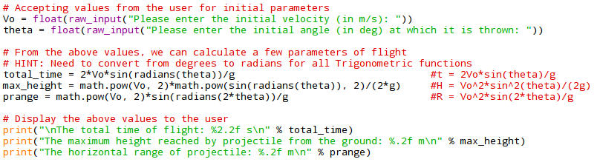
Important Code Snippets (1/2)
THREE things to notice:
We are asking the user to enter values for velocity and angle which we accept as raw_input and convert it into a number (float) for easy use.
These variables are then used to calculate other values using mathematical formulae. The take-away here is to see how easily the mathematical formulae translate into Python code.
These calculated parameters are then printed back to the screen for the user to look at.
These three steps from the crux of almost all procedural programs in STEM fields.

Slide 24
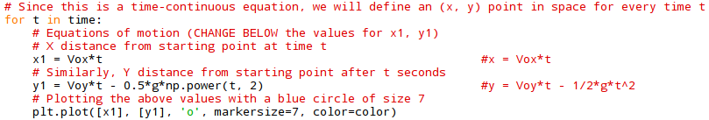
Important Code Snippets (2/2)
These lines contain the essence of the program.
Here we are animating the path of a projectile by plotting its position in 2D space at certain instances of time
We are looking at 21 evenly spaced intervals in total flight time in AnimateProjectile.py
So for each instant t in total_time, we are calculating the value for (x, y) based on mathematical formulae
We are then plotting this point in 2D space with a certain size and color
We then repeat the process for the next value of time t and so on till we land after total_time s has passed

Slide 25
Phase III
This can be done after either Phase I or Phase II.
The idea behind this step is to suggest a slight improvement which will involve changing portions in the code.
This way the student can strengthen the concepts of Python programming and manipulating physical equations.
The change is to implement a program in which the user is allowed to launch a projectile from a certain height, h.
As of now the projectile is being launched from the ground level.

Slide 26
How to: Phase III
First we need to ask the user what height we want to launch the projectile from. This can be done in the same fashion as the initial velocity and launch angle and stored as h
Then we need to incorporate this into the equations of motion we have used previously
If we analyze the problem carefully we can see that there will be no change in the X direction but there will be an added value of h in the Y direction
The program is just calculating the position of a projectile in space (x, y) at a certain time t
So there will be THREE major changes that need to be implemented
Accepting the value of h from the user
Re-calculating the parameters of flight (total_time, max_height, range) based on h
Changing the equation to find y1 based on h

Slide 27
How To: Solutions to Common Errors
Check that your Raspberry Pi is connected to the internet if you’re using Remote Desktop
Make sure that you are in the Python 2.7.9 Shell i.e. NOT the Python 3.4.2 Shell
Ensure that the numpy and matplotlib libraries are downloaded and working
Syntax errors in Python 2 can be easily resolved by looking at example code
Solutions to other errors can be easily found on Google by copying & pasting the message
You can always get in touch with us at ESP4T_TECH@uwyo.edu

Slide 28
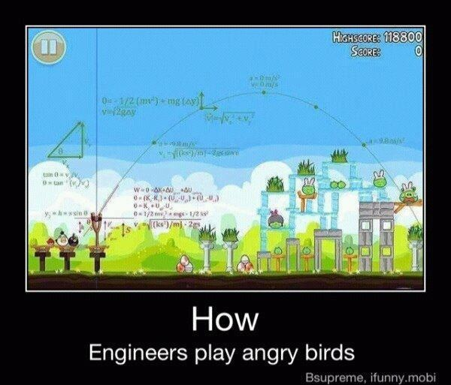
Happy coding!
It’s all in the science and math!

